Slide 1

Chapter 15
Psychological Disorders

Slide 2
Defining Psychological Disorders
How do psychologists define abnormal behavior?
Notes:
2

Slide 3
What Is Abnormal?
Deviance (being atypical)
Norm violation
Insufficient
Violating cultural expectations
Not universally shared
Harmful dysfunction
Must lead to negative consequences
Dysfunction itself alone does not indicate a disorder.
Notes:
Perhaps the simplest way to define disorder is to label behaviors and thoughts that are atypical, or rare, as sign of a disorder. Because if we define normality as what most ppl do, the criterion for ab becomes what ppl rarely do, which deviates from norms. But does statistical infrequency really indicate abnormality? No. Genius is rare, but not abnormal. Another example is that 4% American have red hair, but it’s not a disorder.
Perhaps you may say that having a mental disorder means you do things that are not appropriate, socially and culturally. However, violating cultural expectation is not a satisfactory means of identifying the presence of a psychological disorder. In most parts of the U.S., it’s a social norm or nice gesture to smile at strangers and return strangers’ smile. Not the case in Asia.
Besides these two, another more influential conceptualization of mental disorder was proposed by wakefield, who defined disorder as a harmful dysfunction. The dysfunction must lead to some neg consequences in order to be considered as abnormal. E.g., it’s normal to be sad for a while after something bad happened, but if the sadness is so intense that it interferes with your ability to come to school and go to work, it might be considered as abnormal. But dysfunction itself …

Slide 4
The APA definition
American Psychiatric Association
Significant disturbances in thoughts, feelings, and behaviors.
Such disturbances reflect dysfunction.
Disturbances lead to distress or disability.
Disturbances do not reflect culturally approved response to certain events.
Notes:
A formal definition of a psychological disorder is introduced by APA.
A person must experience some thoughts and feelings and exhibit behaviors that are clearly disturbed. Others around this person would find these thoughts and behaviors very troubling. For example, washing your hand 10 times per hour indicate a disturbance.
The disturbances reflect some kind of bio, psyc, and dev dysfunction. Disturbed patterns of thoughts and behaviors should reflect some flaw in this person’s internal biological, psychological, and developmental mechanism. For instance, hallucination suffered by schizophrenic patients could be a sign of brain dysfunction.
Being shy vs. social anxiety. Social anxiety: avoid all social situations, cannot attend school or apply for a job.
Great great sorrow, crying in the middle of the class, which is considered to be disturbance by you. But if you learned that he/she just lost a close family member, you won’t consider it as a mental disorder.

Slide 5
Classifying Psychological Disorders
How many psychological disorders have been identified?
Notes:
5

Slide 6
Classification Systems
In North America
The Diagnostic and Statistical Manual of Mental Disorders (DSM-5)
Published by the American Psychiatric Association
Latest editions include more than 300 specific diagnostic labels
Outside North America
International Classification of Diseases (ICD-10)
International Classification of Impairments, Disabilities and Handicaps (ICIDH-2)
Published by the World Health Organization
Notes:
How do mental health professionals identify and diagnose mental disorders? Most in the US use the … published by APA.

Slide 7
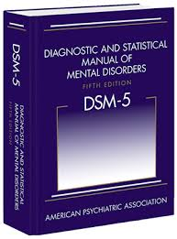
DSM-5 Classification System
Neurodevelopmental disorders
Schizophrenia spectrum and other psychotic disorders
Bipolar and related disorders
Depressive disorders
Anxiety disorders
OCD
Trauma- and stressor-related disorders
…..
Personality disorders
Notes:
The DSM-5 includes many categories of disorders, such as…
Each disorder is described in detail, including an overview of the disorder, specific symptoms required for diagnosis, prevalence information, and risk factors.

Slide 8
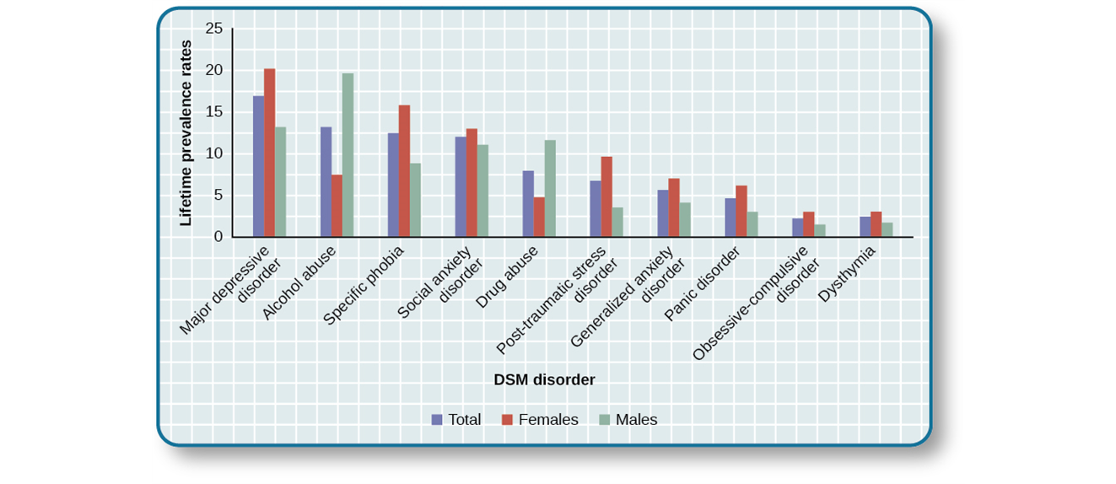
DSM-5 Classification System
The graph shows the breakdown of psychological disorders, comparing the percentage prevalence among adult males and adult females in the United States

Slide 9
Perspectives on Psychological Disorders
What causes abnormality?
Notes:
9

Slide 10
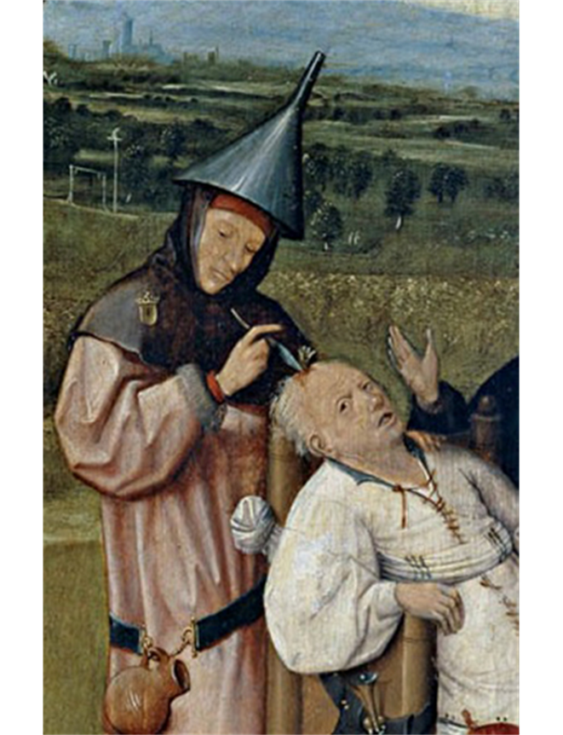
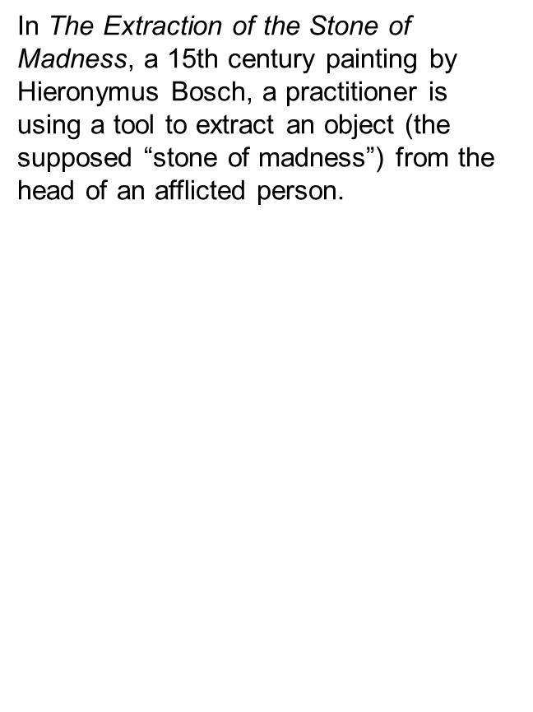
Supernatural Perspectives

Slide 11
The Biological Perspective
Disorders stem primarily from an underlying illness that can be diagnosed, treated, and cured
Biological factors cause mental illness
Physical illnesses
Disruptions or imbalances in bodily processes
Genetic influences

Slide 12
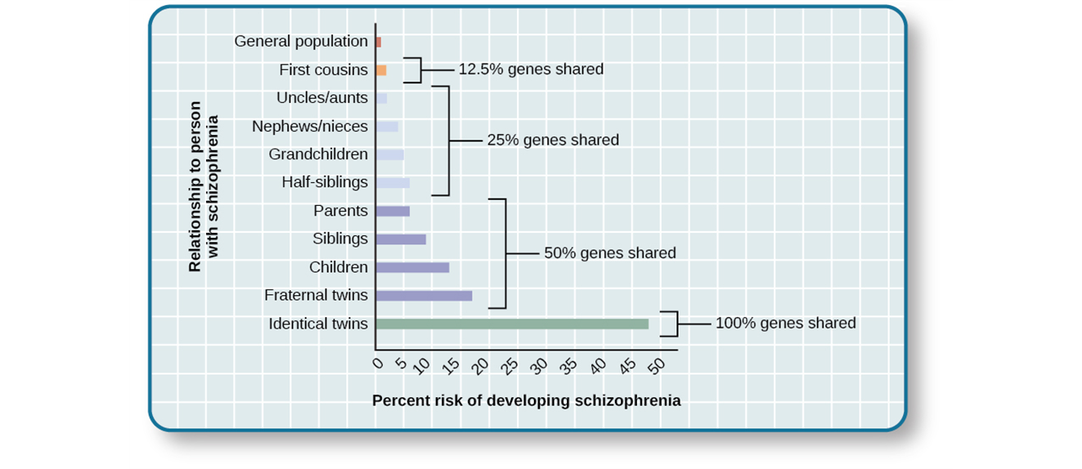
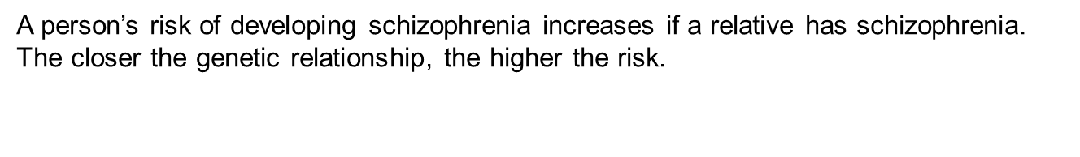

Slide 13
The Psychological Model
Emphasizes psychological factors:
Wants
Needs
Emotions
Learning experiences
Attachment history
World view
Ψ

Slide 14
The Sociocultural Perspective
Sociocultural factors include:
Gender, age, and marital status
Physical, social, and economic situations
Cultural values, traditions, and expectations
Sociocultural factors influence:
What is labeled abnormal
Who displays what kind of disorder
Likelihood of treatment
Overall prevalence of disorders
Form of abnormality

Slide 15
The Diathesis-Stress Model: An Integrative Explanation
Biological, psychological, and sociocultural factors can predispose us toward a disorder
A certain amount of stress is needed to trigger that disorder
If major stressors don’t occur—or if the person has adequate coping skills—symptoms may never appear, or may be relatively mild

Slide 16
Anxiety Disorders
What is a phobia?
Notes:
16

Slide 17
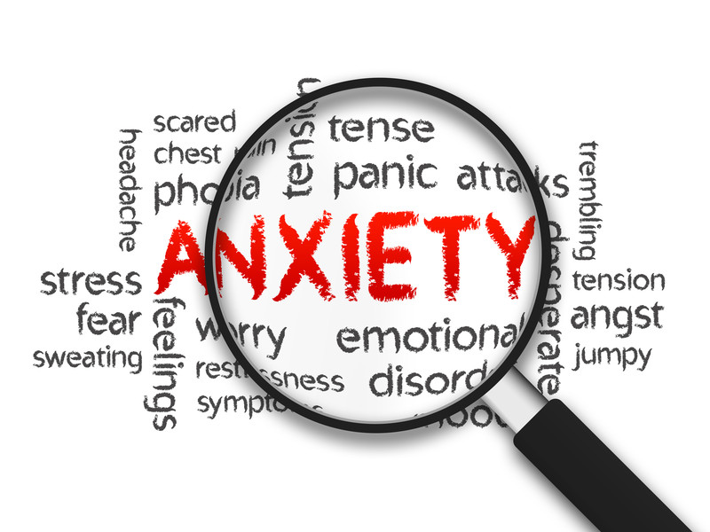
Anxiety Disorders
Characterized by excessive and persistent fear and anxiety, and by related disturbances in behavior.
Are common: About 25-30% of the U.S. population meets the criteria for at least one anxiety disorder during their lifetime.

Slide 18
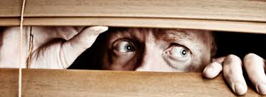
Specific Phobias
Acrophobia: Heights
Claustrophobia: Enclosed spaces
Hematophobia: Blood
Gephyrophobia: Crossing a bridge
Taphophobia: being buried alive
Kenophobia: Empty rooms
Cynophobia: Dogs
Aerophobia: Flying
Entomophobia: Insects
Gamophobia: Marriage
Ophdophobia: Snakes
Xenophobia: Strangers
Melissophobia: Bees
Agoraphobia: a strong fear of being away from a safe place such as home.

Slide 19
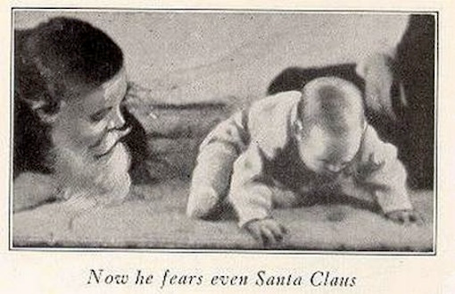
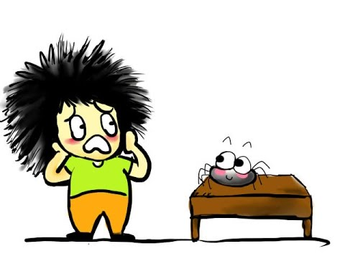

Specific Phobias
Phobias may develop through learning.
Classical conditioning
Vicarious learning (modeling)
Verbal transmission of information.

Slide 20

Social Anxiety Disorder
Extreme and persistent fear or anxiety and avoidance of social situations in which the person could be negatively evaluated by others.
About 12% Americans are affected
When have to be in social situations:
Perform safety behaviors
Resort to self-medication
One major risk factor: behavioral inhibition

Slide 21
Panic Disorder
Recurrent, terrifying panic attacks without warning or obvious cause
Symptoms include:
Intense heart palpitations, pressure or pain in the chest, dizziness or unsteadiness, sweating, and feeling faint
May feel like a heart attack
Restricted activities due to constant worry about suffering future panic episodes
Can lead to agoraphobia
Periods of improvement may be followed by recurrences
Affects 2%-3% of adults in any given year

Slide 22

Generalized Anxiety Disorder
Excessive, long-lasting, unfocused anxiety
Symptoms include jumpiness, irritability, sleeplessness, fatigue, inability to concentrate
Affects about 3% of the U.S. population in any given year and about 6 % of the population at some point in their lives
Median age of onset is 31
More common in women
Often appears with other problems
e.g., depression, substance abuse

Slide 23
Obsessive-Compulsive and Related Disorders
What is a OCD?
Notes:
23

Slide 24

Obsessive-Compulsive Disorder
Obsessions—persistent, upsetting, unwanted thoughts
Compulsions—ritualistic, repetitive behaviors
e.g., checking locks; repeating words, images, or numbers; counting things; or arranging objects “just so”
Prevalence:
Affects about 1% of the population in any given year
Equally common in males and females
Many sufferers know that their thoughts and actions are irrational, but are severely upset or anxious if they try to interrupt obsessions or stop compulsive behaviors

Slide 25


Slide 26
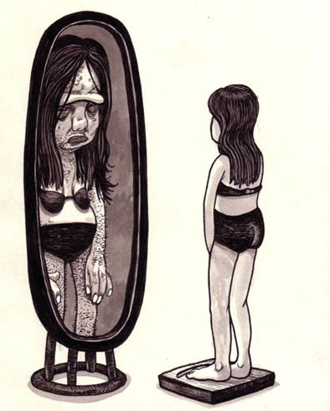
Body Dysmorphic Disorder
Preoccupied with a perceived flaw in his/her physical appearance that is either nonexistent or barely noticeable to others.
The preoccupation drives the person to engage in compulsive behaviors.
About 2.4% Americans are affected.

Slide 27
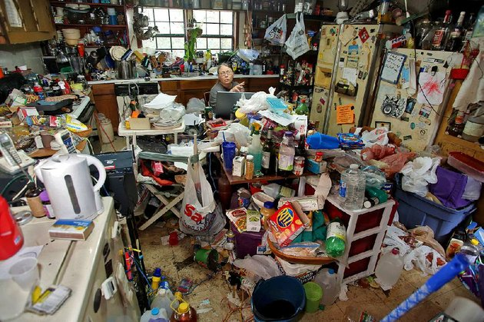
Hoarding Disorder
Hoarding represents an entirely different disorder.
Hoarders: cannot bear to part with personal possessions, regardless of how valueless or useless these possessions are.

Slide 28

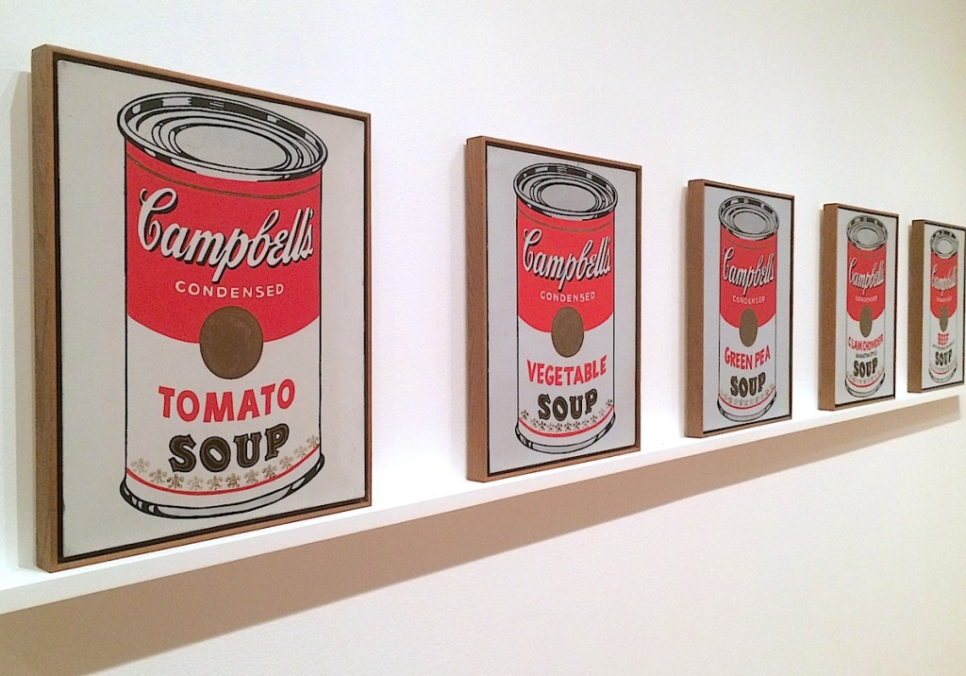
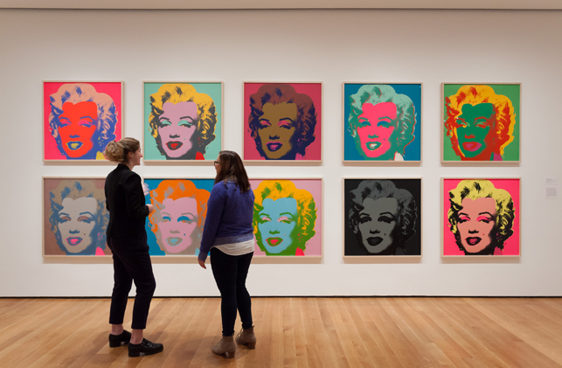

Slide 29
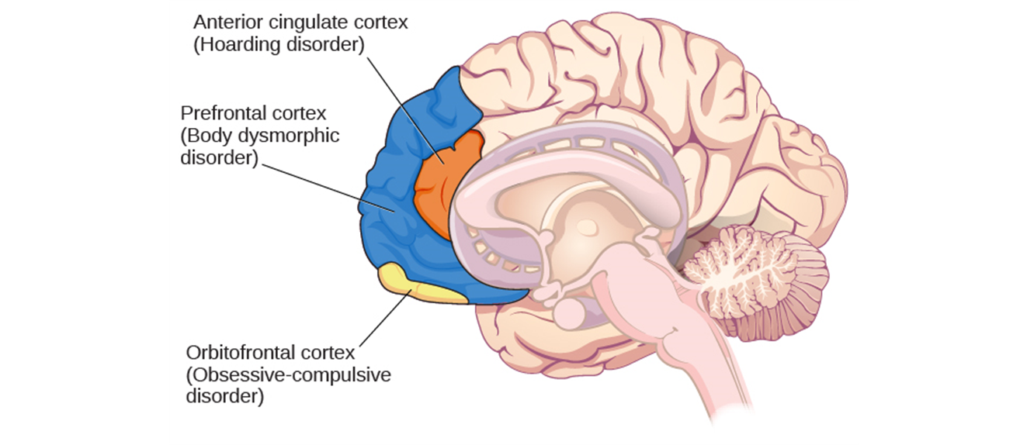
Causes of OCD
Moderate genetic component.
Orbitofrontal cortex

Slide 30
Posttraumatic Stress Disorder
What is a PTSD?
Notes:
30

Slide 31

PTSD
Exposed to, witness, or experience the details of a traumatic experience (actual or threatened death, serious injury, or sexual violence)
Symptoms:
Intrusive memories
Flashbacks
Avoidance of stimuli connected to the event
Persistent negative emotions
Feelings of detachment from others
Irritability, jumpiness, proneness toward outbursts
Roughly 7% American adults are affected.

Slide 32

Risk Factors for PTSD
Environmental:
Traumatic experience
Trauma severity
Lack of social support
Childhood adversity
Personal:
Being female
Low SES
Low intelligence
History of mental disorder
Family history of mental disorder
neuroticism

Slide 33
Mood Disorders
Notes:
33

Slide 34

Major Depression Disorder
May come on suddenly or gradually
One episode or repeated depressive periods
Episodes can last weeks or months
16.9% American will experience it during their lifetime
More common among women

Slide 35
Symptoms of Major Depression
Major symptoms:
Depressed mood most of the day, almost every day
Loss of interest and pleasure in usual activities
Other symptoms:
Significant change in weight/appetite
Sleeping disorder
Psychomotor agitation (being jittery) or retardation (e.g., moves and talks slowly)
Fatigue
Feelings of worthlessness
Difficulty concentrating
Suicidal thoughts

Slide 36
Subtypes of Depression
Seasonal pattern: a person displays the symptoms of major depressive disorder only during a particular time of the year.
Peripartum onset: postpartum depression
Persistent depressive disorder: chronically sad and melancholy, but do not meet all the criteria for major depression

Slide 37
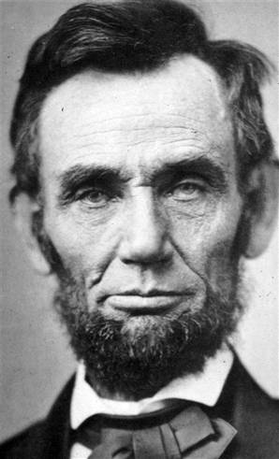

Slide 38
Bipolar Disorder
Experience extreme mood swings between depression and mania.
To be diagnosed, a person must have experienced at least one manic episode in his life
Experience euphoric mood, extremely talkative
Excessively irritably
Flight of ideas, abruptly switching from one topic to another
Grandiosity
Multitasking with little need for sleep
Recklessly engage in pleasurable activities

Slide 39

Risk Factors for Bipolar Disorder
In the U.S., 1 out of 100 meet the criteria within their lifetime.
Higher rates in men.
50% do not receive treatment.
High suicide rate

Slide 40

Biological Basis of Mood Disorders
Genetic
Relatives with someone who has Major Depressive disorder– double the risk of developing it
Relatives with someone who has Bipolar Disorder– nine times the risk of developing it
Biological
Imbalance of Norepinephrine and Serotonin
These are important regulators of bodily functions

Slide 41
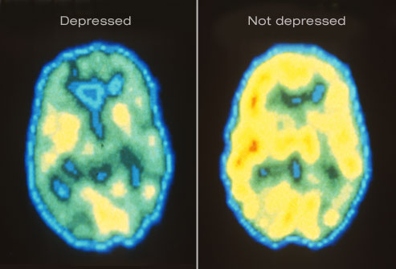
Biological Basis of Mood Disorders
Disorder is linked to abnormal activity in areas of the brain such as the amygdala and prefrontal cortex
Increased activation of amygdala
Less activation of Left PFC
Inability to control negative emotions of the Amygdala

Slide 42
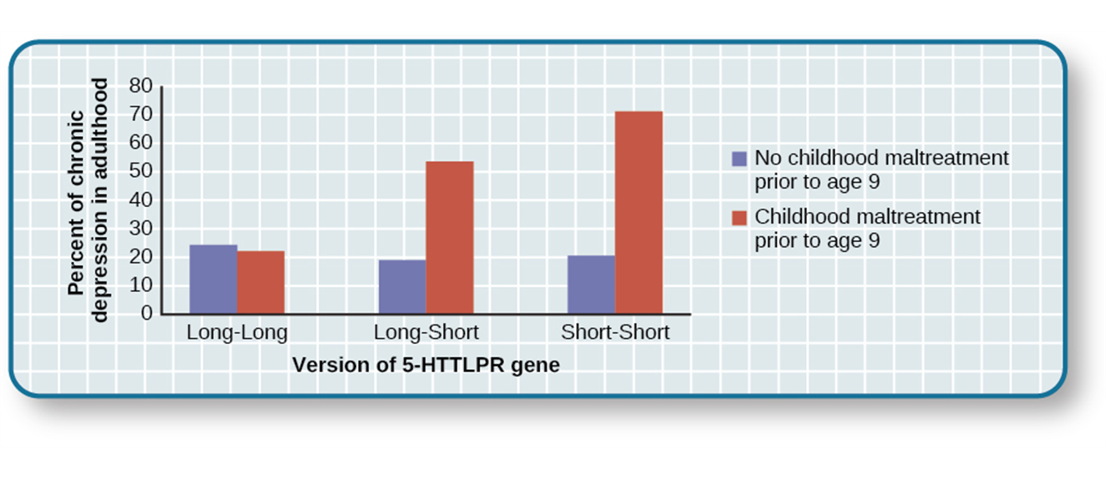
Diathesis-Stress Model and Major Depressive Disorders
Stressful life events can trigger depression
Not everyone who goes through this will succumb to depression
Diathesis-Stress model
5-HTTLPR gene-regulates serotonin
One or two short versions of 5-HTTLPR is paired with a traumatic event
More likely to have experience an episode related to Major Depressive disorder

Slide 43
Cognitive Theories
Diathesis-Stress models suggest it is triggered by cognitive vulnerability and by precipitating stressful life events
Aaron Beck
Developed most well known cognitive theory
Suggests depression-prone people have a predisposition to develop negative schemas
Negative Schemas = mental predisposition to think in negative way
Developed in childhood and remain dormant till triggered by negative/stressful life event

